Slide 1

Neonatal Seizures Induce Significant Changes In Cerebral Oxidative Metabolism
UCL Institute For Women’s Health
Agnieszka Sierhej¹, Alan Bainbridge², Giles Kendall³, Magdalena Sokolska², Janet Rennie³, Sean R Mathieson⁴, Nicola J Robertson³, Geraldine Boylan⁴, Subhabrata Mitra³
1 Queen’s Square Institute of Neurology, University College London, UK
2 Department of Medical Physics and Biomedical Engineering, University College London Hospitals, UK
3 Institute for Women's Health, University College London, London, UK
4 INFANT Research Centre, University College Cork, Cork, Ireland; Department of Paediatrics and Child Health, University College Cork, Cork, Ireland.
Notes:
Comments:
- Check if everyone has been assigned with correct affiliation

Slide 2
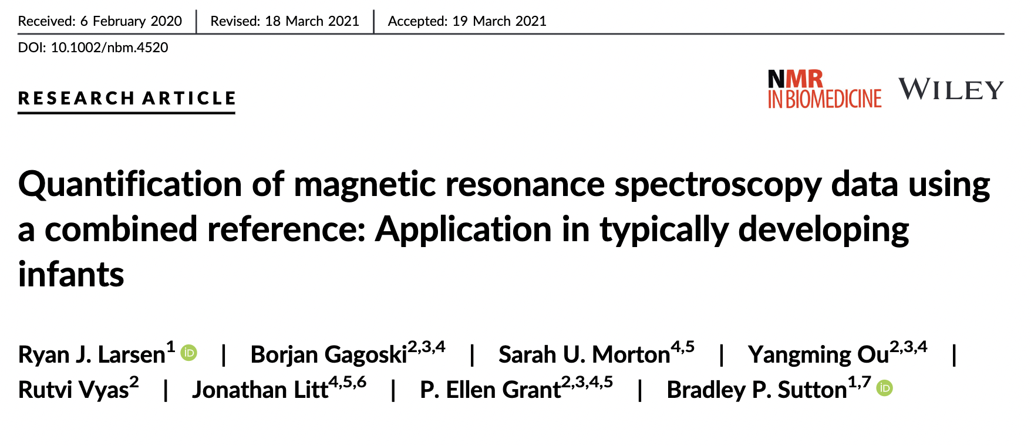
Background
UCL Institute For Women’s Health
Neonatal Seizures
Occur commonly with neonatal encephalopathy (NE). Seizures have the potential for themselves to cause further brain injury.
Proton Magnetic Resonance Spectroscopy (MRS)
Can be used to assesses cerebral metabolism
Metabolite Ratios
A useful way to analyse spectra,
But can be difficult to determine to what extent each metabolite in the ratio is contributing to any observed effect between cohorts.
Larsen et al* have published a new method that uses a Combined Metabolite Reference. This has the potential to show the contribution of each metabolite.
* Combined Metabolite reference
Larsen et al, NMR Biomed 34, 7, 2021
PURPOSE: To compare cohorts of encephalopathic neonates, with and without seizure activity, using Proton MRS and the Combined Metabolite Reference method to identify differences in individual metabolites.
Notes:
Comments:
- How many references?
Put the reference on the slide [done]
Standard background UCL + UCLH logo [done]
Cut down the text

Slide 3

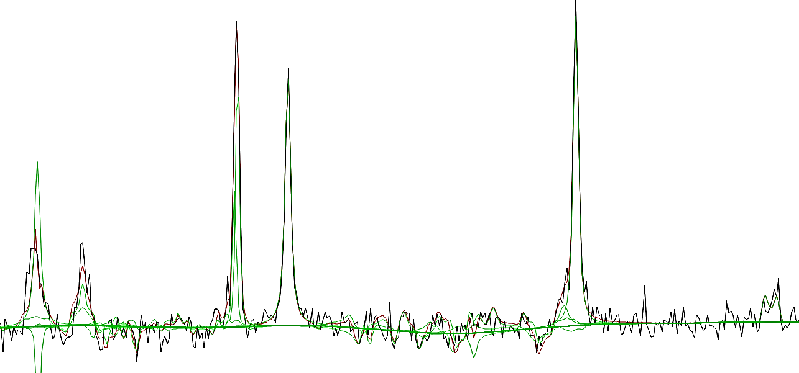
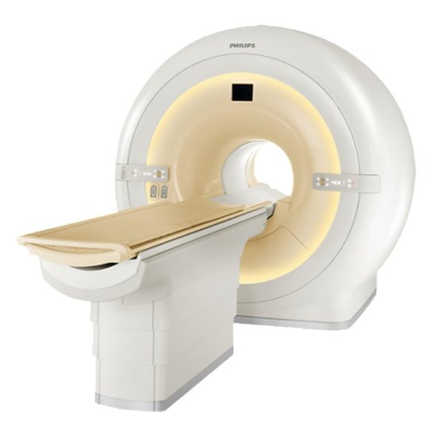
UCL Institute For Women’s Health
Methods
Subjects:
Data Analysis:
55 term neonates
Corrected gestational age: 36 – 44 weeks
29 male : 26 female
All neonates underwent therapeutic hypothermia following NE,
Scanned within the first 2 weeks of life
Continuously monitored during the first 4 days of life with video-EEG.
Data Acquisition:
MRS data were analysed using Tarquin. The basis set for the analysis included threonine (Thr) to improve the fit in the region around 1.3ppm*. The sum of Lactate and threonine is then analysed rather than the fitted lactate alone. Metabolite ratios were calculated from the fitted data.
3T Philips Achieva
Single MRS voxel positioned in the thalamus-basal ganglia region
PRESS, TR = 2288ms, TE = 288ms
Reference: * Mitra et al Arch Dis Child Fetal Neonatal Ed. 2019 Jul;104(4)
Notes:
SUBJECTS: This study was approved by the local Research Ethics Committee and written informed consent was obtained before each study. Data were collected from 55 term neonates (corrected gestational age of 36-44 weeks) (29 male) who underwent therapeutic hypothermia following NE and were scanned within the first 2 weeks of life. All infants were continuously monitored during the first 4 days of life with video-EEG.
DATA ACQUISITION: 3T scanner (Philips Achieva), conventional MRI and MRS, single voxel positioned in the thalamus-basal ganglia region (PRESS, TR = 2288ms, TE = 288ms).
DATA ANALYSIS: MRS data were analysed using Tarquin (Fig. 1). The basis set for the analysis included threonine (Thr) to improve the fit in the region around 1.3ppm (2). The sum of Lactate and threonine is then analysed rather than the fitted lactate alone. Metabolite ratios were calculated from the fitted data.

Slide 4
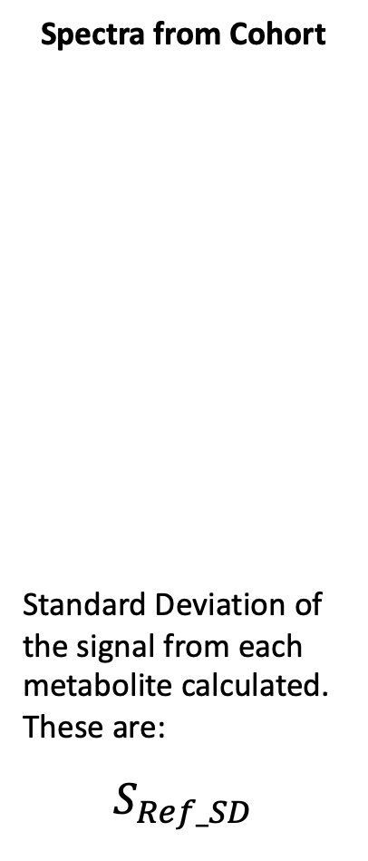
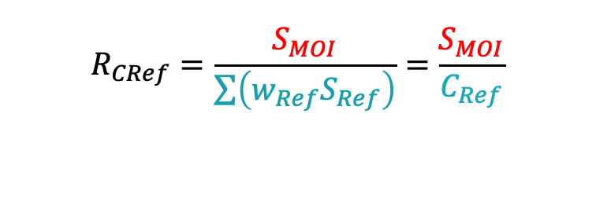

UCL Institute For Women’s Health
Combined Metabolite Reference
Spectra from Cohort
Standard Deviation of the signal from each metabolite calculated. These are:
$S_{Ref_SD}$
Calculate Combined Reference ratio, R_{CRef} for each metabolite of interest
Test for Normality
Metabolite with signals that are normally distributed within the cohort are included in the combined reference, C_{ref}
(Tested using Shapiro-Wilks)
Calculate Weightings
The weighting for each metabolite in the combined reference is calculated as the sum of the SDs of all included metabolites divided by the SD of the individual metabolite
$$w_{Ref}=\frac{\sum{S_{Ref_SD}}}{S_{Ref_SD}}$$
Calculated for each metabolite in C_{ref}
W_{Ref} = Weighting
S_{Ref} = Signal Amplitude
Calculated for Metabolite of Interest
S_{MOI} = signal amplitude
$$R_{CRef}=\frac{S_{MOI}}{\sum{\left(w_{Ref}S_{Ref}\right)}}=\frac{S_{MOI}}{C_{Ref}}$$
Notes:
The data were further analysed using a combined reference method of Larsen et al [1]. Briefly, the standard deviation of the metabolite signals from the entire cohort ($\sum{S_{Ref_SD}}$). are calculated and used to produce weightings (w_{Ref}) that are inversely proportional to the standard deviation of each metabolite within the cohort (S_{ref_SD}). For this analysis, the metabolite signal amplitude distributions were tested for normality using a Shapiro-Wilk test and only those metabolites that were normally distributed were considered for inclusion in the combined reference. For each individual spectrum analysis (S_{MOI}), the combined reference (C_{Ref}) is then the weighted sum of the fitted values of the included metabolites in that spectrum (S_{ref}). Results are presented as the individual metabolite of interest ratioed to C_{Ref}.
Metabolite ratios including lactate in cohorts of neonates with NE are often not normally distributed. Therefore for statistical comparisons using parametric tests the logarithms of the metabolite ratios are first calculated. Comparisons between the cohorts made using t-tests with a Bonferroni correction of the p-value to account for multiple comparisons.

Slide 5
UCL Institute For Women’s Health
Results
Metabolite peak area ratios | Seizures (n = 25) * (Mean + SD) | Non-Seizures (N=30) (Mean + SD) | P value (t test – Bonferroni corrected)
(Lac + Thr) / tNaa | 1.1 (1.3) | 0.2 (0.1) | 0.00036
(Lac + Thr) / tCho | 1.6 (1.5) | 0.4 (0.2) | 0.00026
(Lac + Thr) / Cr | 0.8 (0.8) | 0.2 (0.1) | 0.001
tNaa / Cr | 1.0 (0.2) | 1.3 (0.2) | 0.00025
R_{CRef}: Individual metabolites / C_{ref} **
(Lac + Thr) | 0.020 (0.020) | 0.008 (0.002) | 0.00135
tNaa | 0.028 (0.010) | 0.041 (0.006) | 0.00028
tCho | 0.015 (0.005) | 0.018 (0.003) | 0.00626
Cr | 0.028 (0.005) | 0.032 (0.003) | 0.04328
* Total seizure burden in the seizure cohort ranged from 1.92 mins to 614.95 mins (mean=162.91 mins; SD=147.48 mins).
** The metabolites included in C_{Ref} were Aspartate, Creatine(Cr), total Choline (tCho), total Naa (tNaa), Taurine and Glutamate+glutamine (Glx).
Notes:
2 decimal points of precision

Slide 6
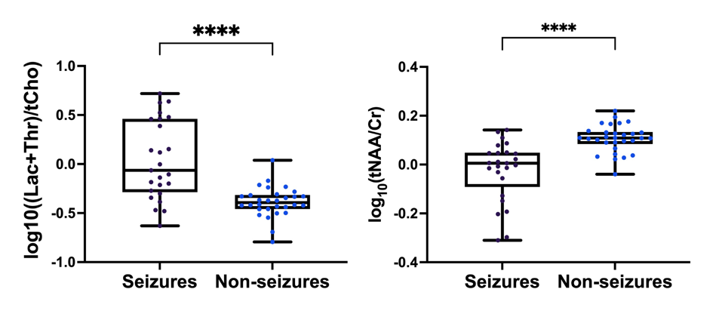
UCL Institute For Women’s Health
Results
Log10 of metabolite ratios plotted for neonates with seizures and non-seizures.
For neonates with Seizures:
Lac+Thr/tNaa, Lac+Thr/tCho and Lac+Thr/Cr were all significantly higher
tNaa/Cr was significantly lower

Slide 7
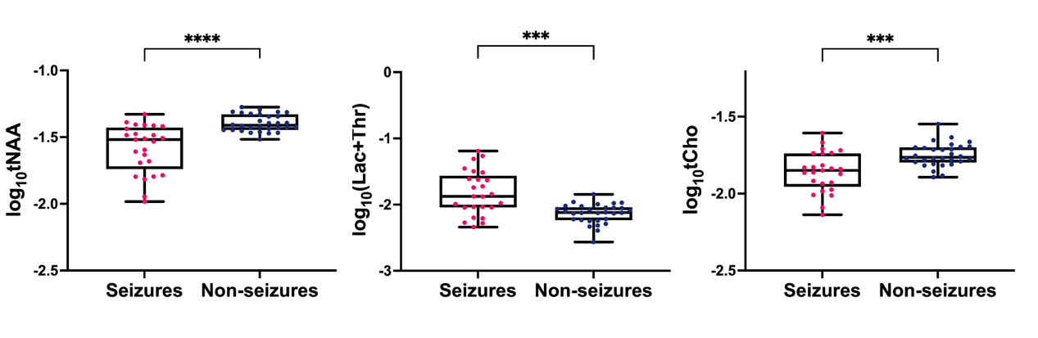
UCL Institute For Women’s Health
Results
Log10 of metabolite Combined Reference Ratio plotted for neonates with seizures and non-seizures.
For neonates with Seizures:
Lac+Thr was significantly higher
tNaa and Tcho were significantly lower

Slide 8




UCL Institute For Women’s Health
Conclusions
Acknowledgements
Neonatal seizures induce significant changes in cerebral metabolism.
The C_{Ref} method shows better the relationship of individual metabolites to the presence of seizures.
Our study supports previous finding* of ↑Lac+Thr/Cho in neonates with seizures and identify changes in individual metabolites.
Changes in ratios are driven both by ↑(Lac+Thr) (increased anaerobic state) and ↓tCho in neonates with seizures (deranged phospholipid metabolism).
↓tNaa in neonates with seizures likely indicates further neuronal injury and may explain seizure induced neurological deficits.
Reference: * Miller et al. Neurology. 2002
Notes:
Comments:
More refrences?
Previous findings – refrencs?

